Slide 1

COMMUNICATION & PRESENTATION SKILLS (CPS)
Course Instructor : Ms Madiha Rehman
Week: 01
Duration of Week Class: 2 hrs.

Slide 2
CONTENTS
Definition of Communication
Communication Theory
Types of Communication
Process of Communication

Slide 3
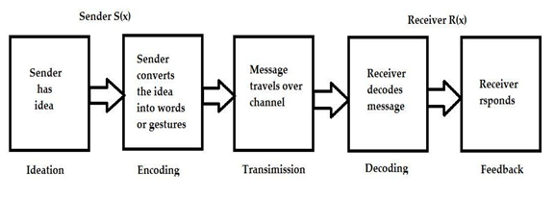
Process (Stages) of Communication
Transmission*

Slide 4
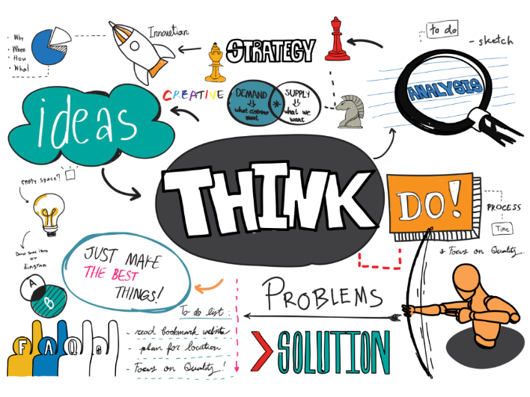
Process (Stages) of Communication
Ideation
The sender has an idea
The idea (message) has two kinds of contents
Logical Message
Emotional Message
Ideation may consist of selecting topic/idea & looking for thoughts regarding it.

Slide 5
Process (Stages) of Communication
1. Ideation
The sender has an idea
The idea (message) has two kinds of contents
Logical Message
Logical message consists of factual information
2. Emotional Message
Consists of feelings and emotions

Slide 6
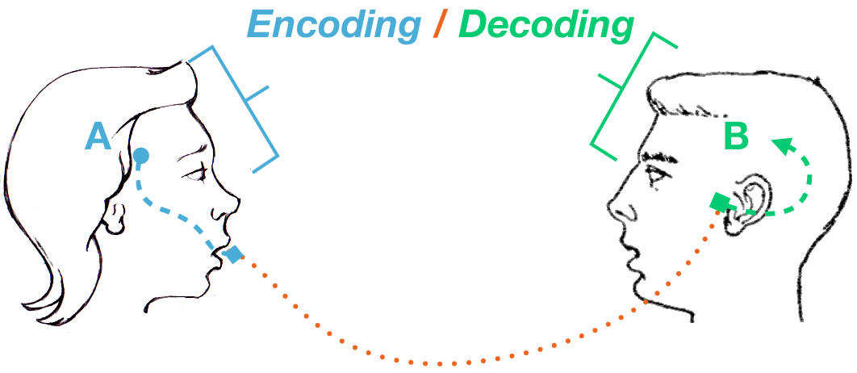
Process (Stages) of Communication
2. Encoding
Process of changing information into some form of logical & coded message.
Process is based on the purpose of communication & the relation between sender & receiver.
In formal situation, encoding involves
Selecting a language
Selecting medium of communication
Selecting an appropriate communication form

Slide 7


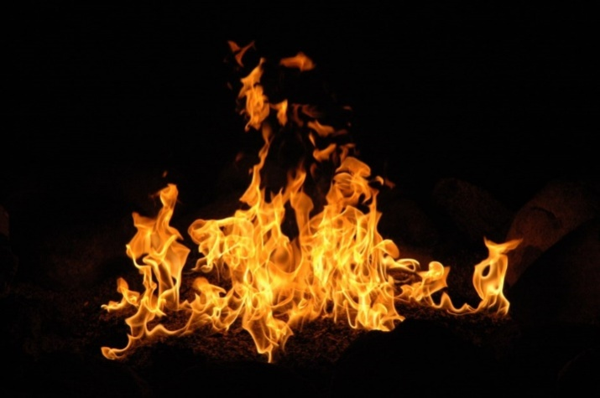
Process (Stages) of Communication
2. Encoding
Selecting The Language
If you encode the message in Pashto/Sindhi or Spanish, the receiver who is unaware about the language will not able to decode your message.
Selecting Medium of Communication
Speaking, writing, non-verbal/symbol
Selecting the Appropriate Form
Depends on sender-receiver relationship
Overall goal of the communicative situation

Slide 8
Process (Stages) of Communication
3. Transmission ( message travels over channel)
Flow of message over the chosen channel
It is essential to know why, where, & how to communicate

Slide 9
Process (Stages) of Communication
4. Decoding
Process of converting message into thoughts translating the received stimuli into meaning to understand the message communicated.
It is important to note that it is the message that is transferred as meaning can not be transferred from one person to another
Decoding involves interpretation & analysis of a message.
Decoding in written communication refers to reading and understanding a written message.

Slide 10
Process (Stages) of Communication
5. Feedback ( Response)
Last stage of communication
It is the action or reaction of the receiver to a message
Message was received & understood
Response is the key of communication.
The effective communication depends on how congruent a receiver’s response is with the meaning intended by the sender.

Slide 11

Differences Between General & Technical Communication
General Communication
General content
no formal elements
both formal and informal in style
May not be factual
Both objective and subjective
Not always structured
Not always for a specific audience
Technical Communication
Technical content
Specialized vocabulary
Formal elements
Always formal in style
Objective
Complex and important exposition techniques
Specific audience

Slide 12
What is Technical Communication
Technical communication is the transmission of technical and professional information from one individual or group to another.
Subject Competence
Linguistics Competence
Organizational competence

Slide 13
Progress Check
Which of the following statements about the steps of communication are not true?
1. The process of communication begins when the sender converts the idea into words or gestures.
2. Decoding relates to the sender of a message
3. It is the duty of the receiver to keep the communication channel free from interference.
4. A formal communication channel is the process of communication that is followed in organizational management
5. Formal communication channels are based on social relationships in which employees talk about work during informal social gatherings.

Slide 14
Progress Check
Which of the following statements about the steps of communication are not true?
6. The responses of the receiver creates feedback.
7. Organizational communication is all about pictures and graphics.
8. Communication is designed to achieve a goal.
9. You may use specific set of words, gestures, and images to convey what you want to say.
10. Communication involves only words.

